Slide 1
PROBABILITY

Slide 2
What is a probability ?
Probability is simply how likely something is to happen.
Whenever we’re unsure about the outcome of an event, we can talk about the probabilities of certain outcomes—how likely they are.
probability ranges between 0 to 1 .
The number of ways it can happen / The number of possible outcomes.
Probability = Ways / outcomes.
The best example for understanding probability is flipping a coin:
There are two possible outcomes—heads or tails.
probability(Head) is 0.5
Probability(Tail) is 0.5

Slide 3
What are Mutually Exclusive Events?
In statistics and probability theory, two events are mutually exclusive if they cannot occur at the same time. The simplest example of mutually exclusive events is a coin toss. A tossed coin outcome can be either head or tails, but both outcomes cannot occur simultaneously.
The two events cannot occur at the same time.

Slide 4
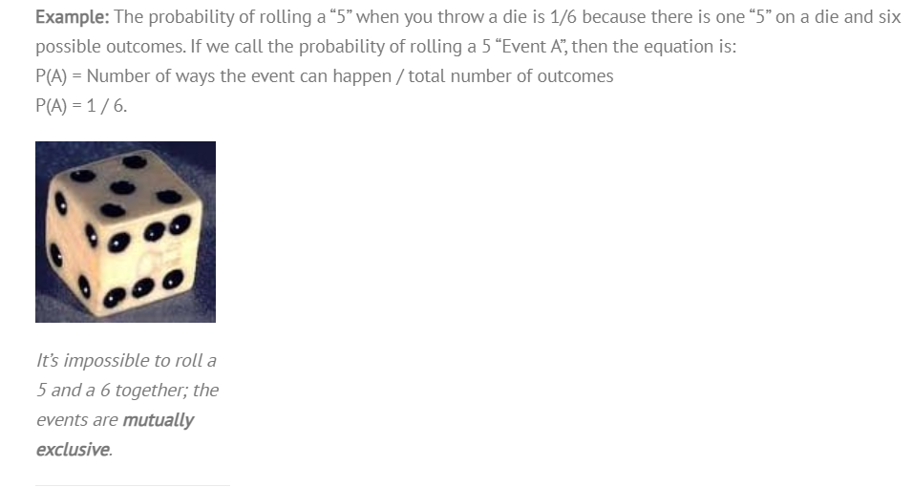
What are Mutually Exclusive Events?

Slide 5
What are Mutually inclusive Events?
Mutually inclusive events have some overlap with each other. For example, the events “buying an alarm system” and “buying bucket seats” are mutually inclusive, as both events can happen at the same time. In other words, a car buyer can opt to buy and alarm and bucket seats. On a Venn diagram, this overlap is shown as an intersection of two circles:
For any two events A and B: P(A or B) = P(A) + P(B) – P(A and B).
Example: if you choose a card from a standard deck of cards, what is the probability of getting a queen or a heart?
It’s possible to get a queen and a heart when choosing a card from a deck of cards. The queen of hearts is the intersection P(A and B), so:
P(Getting a queen or Getting a heart) = P(queen) + P(heart) – P(queen of hearts) = 4/52 + 13/52 – 1/52 = 16/52.

Slide 6
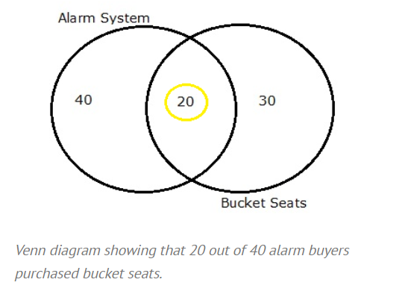
What are Mutually inclusive Events?

Slide 7
DEPENDENT EVENTS:
When two events are dependent events, one event influences the probability of another event. A dependent event is an event that relies on another event to happen first.
Simple examples of dependent events:
Robbing a bank and going to jail.
Not paying your power bill on time and having your power cut off.
Boarding a plane first and finding a good seat.
Parking illegally and getting a parking ticket. Parking illegally increases your odds of getting a ticket.
Buying ten lottery tickets and winning the lottery. The more tickets you buy, the greater your odds of winning.
Driving a car and getting in a traffic accident.

Slide 8
What is an Independent Event?
An independent event is an event that has no connection to another event’s chances of happening (or not happening). In other words, the event has no effect on the probability of another event occurring. Independent events in probability are no different from independent events in real life. Where you work has no effect on what color car you drive. Buying a lottery ticket has no effect on having a child with blue eyes.
When two events are independent, one event does not influence the probability of another event.
Simple examples of independent events:
Owning a dog and growing your own herb garden.
Paying off your mortgage early and owning a Chevy Cavalier.
Winning the lottery and running out of milk.
Buying a lottery ticket and finding a penny on the floor (your odds of finding a penny does not depend on you buying a lottery ticket).
Taking a cab home and finding your favorite movie on cable.
Getting a parking ticket and playing craps at the casino.

Slide 9
CONDITIONAL PROBABILITY.
Conditional probability is defined as the likelihood of an event or outcome occurring, based on the occurrence of a previous event or outcome. Conditional probability is calculated by multiplying the probability of the preceding event by the updated probability of the succeeding, or conditional, event.
For Example : Event A is that an individual applying for college will be accepted. There is an 80% chance that this individual will be accepted to college.
Event B is that this individual will be given dormitory housing. Dormitory housing will only be provided for 60% of all of the accepted students.
P (Accepted and dormitory housing) = P (Dormitory Housing | Accepted) P (Accepted) = (0.60)*(0.80) = 0.48.
Conditional Probability Formula
P(B|A) = P(A and B) / P(A)
Or
P(B|A) = P(A∩B) / P(A).

Slide 10
What Is Bayes' Theorem?
Bayes' theorem is also called Bayes' Rule or Bayes' Law and is the foundation of the field of Bayesian statistics.
Bayes' theorem allows you to update predicted probabilities of an event by incorporating new information.
Bayes' theorem was named after 18th-century mathematician Thomas Bayes.
It is often employed in finance in updating risk evaluation.

Slide 11
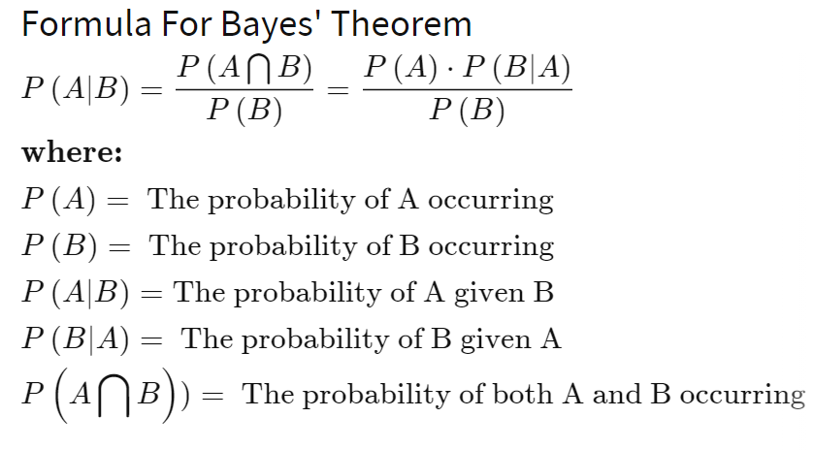
Bayes' Theorem

Slide 12
ASSIGNMENT ON PROBABILITY:
Ques1 : What is the probability of spinning a prime number or an odd number on a spinner numbered 1 to 8 ?
Sol: (1 , 2, 3, 4, 5, 6, 7, 8)
= p(prime) = 4/8 = ½
p(odd) = 4/8 = ½
P(prime & odd) = 3/8
So, p(primeorodd) = ½ + ½ - 3/8
1 – 3/8
= 5/8
Ques2: For numbers, one to nine, get the probability of getting a number less than 4 or 2?
Sol: (1, 2, 3, 4, 5, 6, 7, 8, 9)
= 4/9

Slide 13
ASSIGNMENT ON PROBABILITY:
Ques3: Let X and Y are two independent events such that P(X) = 0.3 and P(Y) = 0.7. Find P(X and Y), P(X or Y).
Sol: P(X and Y) = P(X) * P(Y)
= 0.3 * 0.7 = 0.21
P(X or B) = P(X) + P(Y)
= 0.3 + 0.7 = 1

Slide 14
ASSIGNMENT ON PROBABILITY:
Q.)A bag contains red and blue marbles. Two marbles are drawn without replacement. The probability of selecting a red marble and then a blue marble is 0.28. The probability of selecting a red marble on the first draw is 0.5. What is the probability of selecting a blue marble on the second draw, given that the first marble drawn was red ?
P(B / R) = P(B ∩ R) / P(R)
= 0.28 / 0.5
= 0.56

